Slide 1

Marathwada Mitra Mandal's
COLLEGE OF ENGINEERING, Karve Nagar, Pune - 52
An Autonomous Institute Affiliated to SPPU
Website: www.mmcoe.edu.in email id: mmcoe@mmcoe.edu.in
Department of Information Technology
Project Based Learning - Review 1 (AY 2025-26)
“EduBridge”
Presented By: <<SI154 Gaurav Jadhav>>
<<SI167 Shreyash Mandlapure>>
Name of Guide: Mrs. S P Vanjari
Date: 27/09/2025

Slide 2
Recap of Selected Problem
Previous Problem Statement :
Students in rural areas often lack access to high-speed internet, making existing online exam proctoring solutions ineffective. There is a need for a low-bandwidth, secure proctoring system that ensures fair online assessments without relying on continuous video streaming.
Current Problem Statement(SIH 2025) :
Rural diploma colleges often lack subject lecturers in advanced domains such as Artificial Intelligence, VLSI, and Renewable Energy. Students are left to depend on self-study or costly city-based coaching, widening the urban-rural learning gap. Existing online solutions fail due to unstable, low-bandwidth connectivity and the need for complex infrastructure. There is a critical need for a lightweight, software-only virtual classroom ecosystem that ensures clear audio, compressed visuals, offline-accessible recordings, and interactive features like quizzes and discussion boards—all optimized for entry-level smartphones and minimal data usage. The solution must be simple for faculty to use, affordable for institutions, and sustainable in low-resource environments.

Slide 3
EduBridge
Remote Classroom for Rural Colleges
Context of the project : Rural diploma colleges lack subject lecturers in fields like AI, VLSI, and renewable energy. Existing e-learning solutions fail due to unstable internet, high bandwidth requirements, costly infrastructure, and limited device compatibility. Area/Community of focus: Rural and semi-urban diploma colleges in India Students dependent on self-study and low-cost smartphones with limited data access Urban faculty providing remote expertise needing simple, low-cost teaching tools

Slide 4
Literature Review
Sr. No. | Paper Title | Publication/Author Details | Findings
1. | National Education Policy | India’s National Educational Policy 2020 | Technology Integration Mandate, Digital Equity Focus, Infrastructure Challenges, Quality Standards
2. | Modeling of simulation of computer networks and systems : Methodologies and applications | Obaidat, P. Nicopolitidis | Provide only 6% of network capacity as compared to urban, Network Performance Simulation, Prioritize audio quality and compressed visual content delivery, Adaptive Protocols for Low Bandwidth
3. | Comparative Analysis of Mobile Learning Applications for Higher Education in Low-Bandwidth Environments. | Chavan, Dinesh B. and Roshni Mhatre. International Academic Journal of Science and Engineering (2025): n. Pag. | Khan Academy and Moodle Mobile achieved the fastest load times (3.9 s, 4.2 s) and lowest data usage (5.6 MB, 6.3 MB), , user satisfaction favored simple designs with robust offline access, buffering issues and high bandwidth needs hindered Coursera, recommendations include adaptive streaming, progressive downloading, and localized caching for low-bandwidth environments

Slide 5
Literature Review
Sr. No. | Paper Title | Publication/Author Details | Findings
1. | Post-Streaming Wastage Analysis – A Data Wastage Aware Framework in Mobile Video Streaming. | Zhang, Guanghui, Ke Liu, Haibo Hu, Vaneet Aggarwal and Jack Y. B. Lee. IEEE Transactions on Mobile Computing 22 (2023): 389-401. | 25.2% to 51.7% of video data downloaded is wasted, PSWA framework reduces wastage by up to 80%, 40.2% to 78.3% wastage reduction achieved with minimal QoE loss, Higher throughput networks show more data wastage, Early departure and video skip behaviors cause significant bandwidth waste
2. | Remote learning via video conferencing technologies: Implications for research and practice | Camilleri, Mark Anthony and Adriana Caterina Camilleri. Technology in Society 68 (2022): 101881 - 101881. | Reliable infrastructure and support (facilitating conditions) enhance perceived interactivity, Easy-to-use systems (effort expectancy) strengthen performance expectations.

Slide 6
Community/ Field Visit
Sr. No. | Area Visited | People Consulted | Observations
1. | Solapur(Online Mode) | Mrs. Harshada Supate (Principal - Diploma College) | In the diploma college computer lab, 70% of students’ smartphones automatically switch from 4G to 2G mid-lecture due to network fluctuations, causing frequent audio dropouts. Lab instructor observed that students spent 30 minutes daily downloading recorded lectures over two days because of intermittent connectivity and 500 MB data caps.
2. | Solapur(Online Mode) | Mr. Prashant Jadhav (Asst. Prof - Engineering College) | peak-hour data speeds on campus Wi-Fi drop below 128 kbps, making live video streams lag by 15–20 seconds. students prefer audio-only live sessions with slide captions over full video to conserve data.

Slide 7
Objectives
Problem Statement :
Rural diploma colleges often lack subject lecturers in advanced domains such as Artificial Intelligence, VLSI, and Renewable Energy. Students are left to depend on self-study or costly city-based coaching, widening the urban-rural learning gap. Existing online solutions fail due to unstable, low-bandwidth connectivity and the need for complex infrastructure. There is a critical need for a lightweight, software-only virtual classroom ecosystem that ensures clear audio, compressed visuals, offline-accessible recordings, and interactive features like quizzes and discussion boards—all optimized for entry-level smartphones and minimal data usage. The solution must be simple for faculty to use, affordable for institutions, and sustainable in low-resource environments.
As per the following Literature Survey we can conclude the following objectives
Objectives :
Develop a low-bandwidth optimized virtual classroom system.
Ensure audio-first delivery with compressed visuals for clarity.
Provide both live interaction and offline access to lectures.
Enable quizzes, polls, and discussion boards at minimal bandwidth.
Design a solution that is mobile-friendly, simple, and cost-effective.

Slide 8
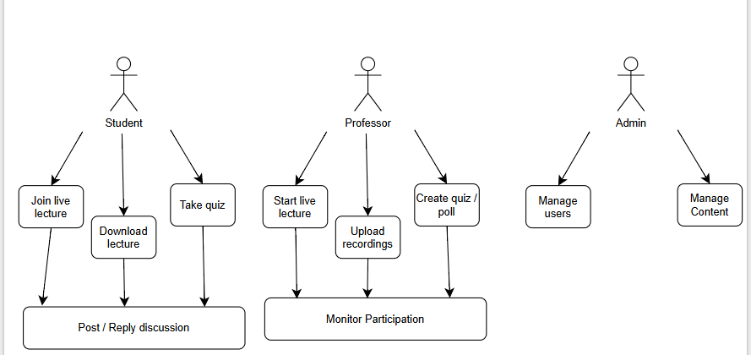
Activity Diagram

Slide 9
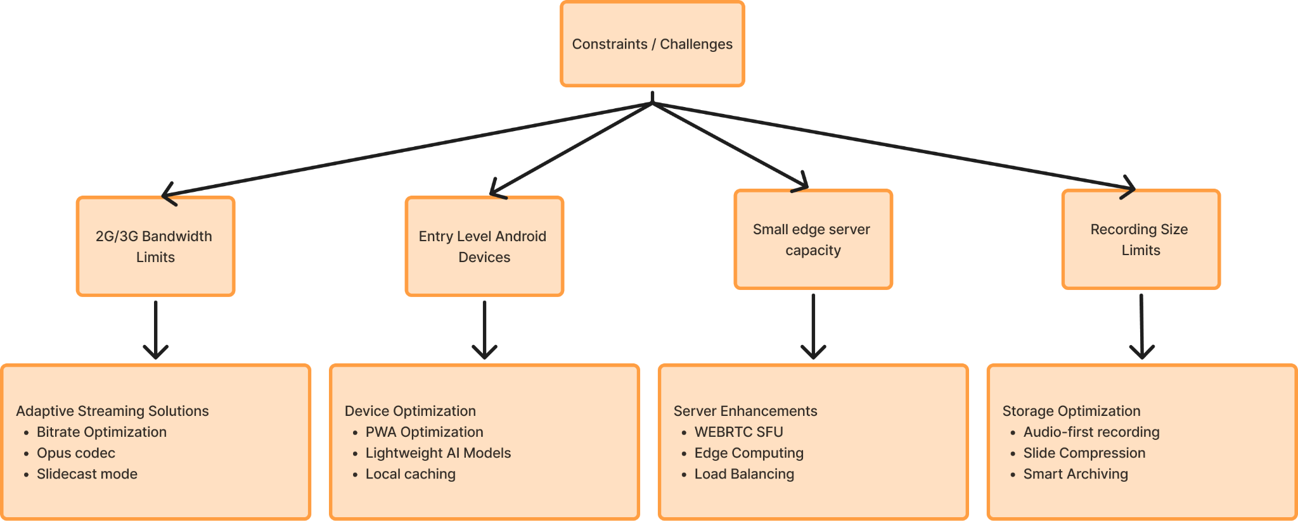
Constraints | Challenges | Solutions
Methodology

Slide 10
Q and A
Thank You

